Slide 1

🎵 Spotify Music Data Analysis & Popularity Prediction
A Machine Learning Project
Prepared by: APARNA U | Tool: Python, ML, Power BI

Slide 2





Unlocking Music Insights: An Introduction
Massive Data Streams
Music platforms generate vast amounts of data daily.
Rich Audio Features
Spotify provides detailed insights into each track's characteristics.
Understanding Preferences
Data analytics helps us understand listener preferences and trends.
Predicting Popularity
Analyzing data to predict song popularity using machine learning.

Slide 3



The Popularity Puzzle: Problem Statement
Complex Factors
Identification Challenge
Industry Needs
Song popularity is influenced by numerous audio and musical elements.
Manually identifying impact of each feature is difficult.
Artists and producers require data-driven insights for success.
The Challenge: Predict song popularity using Spotify audio features via Machine Learning.

Slide 4


Dataset Overview: The Raw Material
Source & Scope
Key Features
Data Source: Spotify Music Dataset
Danceability: How suitable for dancing
Total Records: Thousands of tracks
Energy: Intensity and activity
Loudness: Overall volume
Speechiness: Presence of spoken words
Acousticness: How acoustic a track is
Tempo: Speed/pace of the track
Target Variable: Popularity score (0-100)
Preprocessing Steps:
Missing values removed, feature scaling applied for optimal model performance.

Slide 5
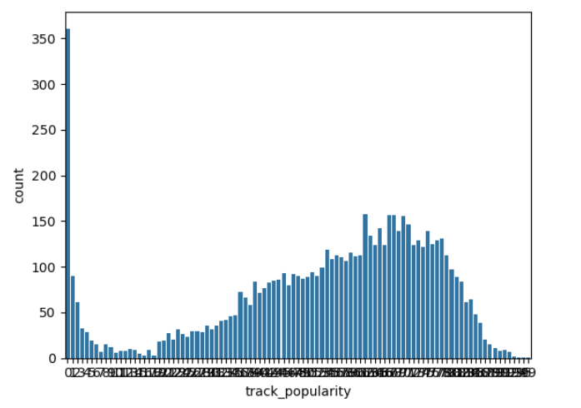
COUNT PLOT

Slide 6
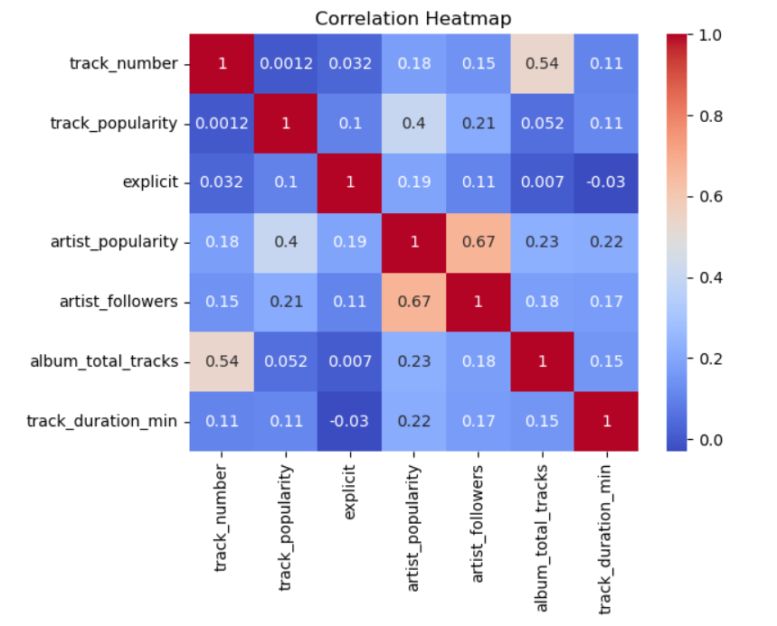
HEATMAP

Slide 7
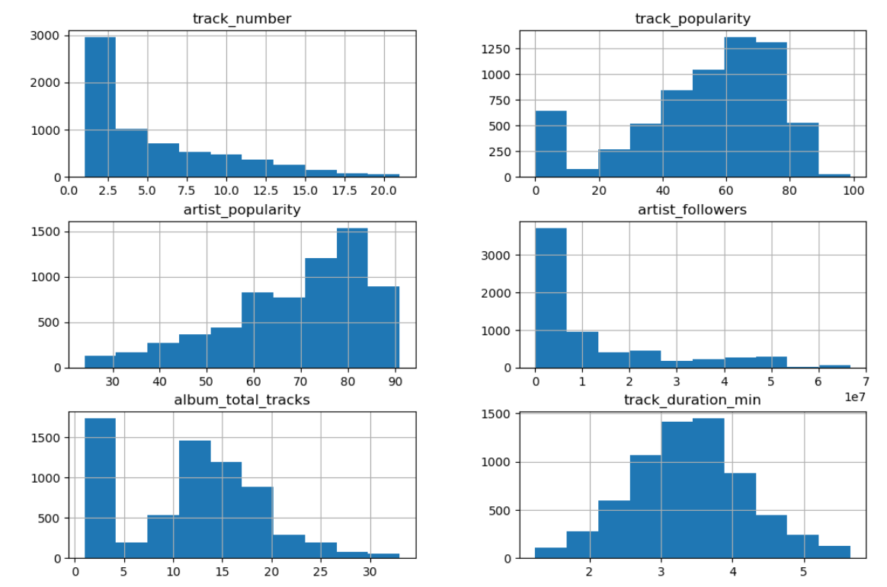

Slide 8




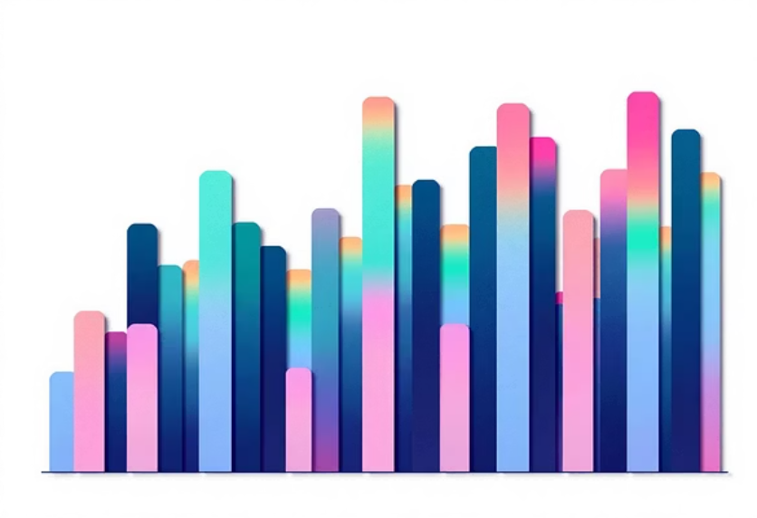
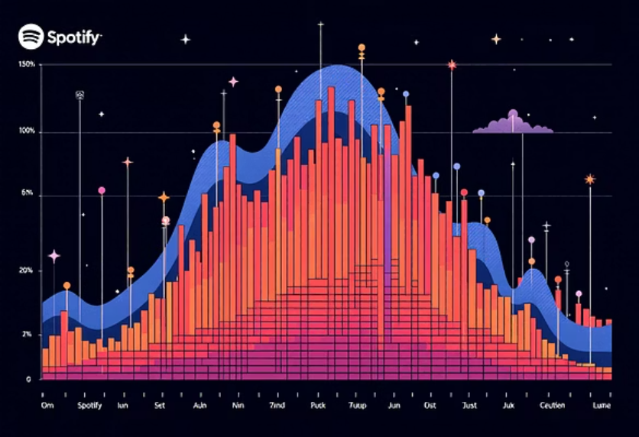
Exploratory Data Analysis (EDA): Uncovering Trends
Popularity Distribution
Feature Correlation
Analysis of song popularity scores across the dataset.
Examining relationships between audio features.
Key Indicators
Loudness Impact
High-energy and danceable tracks often correlate with higher popularity.
A clear positive correlation observed between loudness and popularity.
Tools Used: Matplotlib and Seaborn for comprehensive visualizations.

Slide 9
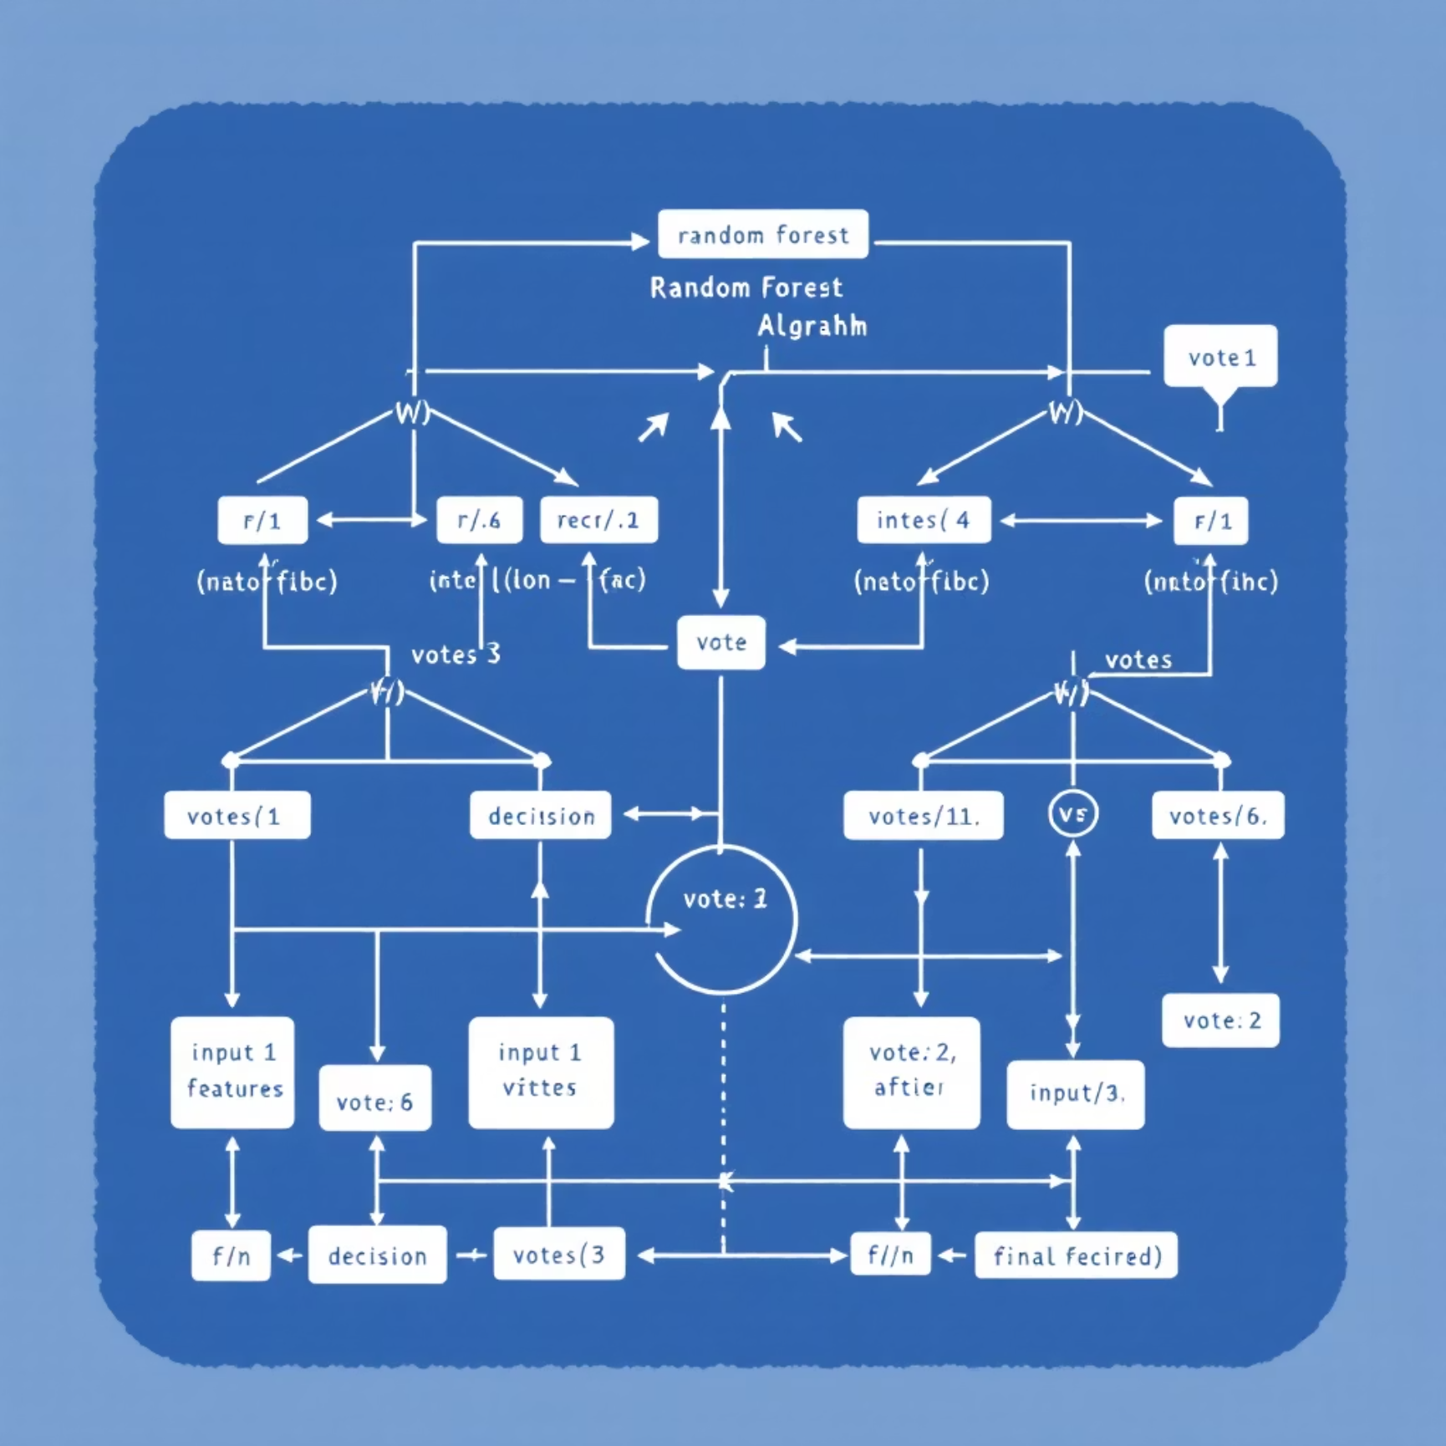

Model Implementation & Performance
Models Explored
Linear Regression: A baseline for predicting continuous values.
Random Forest Regressor: Ensemble method for improved accuracy.
Methodology
Feature scaling with StandardScaler.
Train-test split for robust evaluation.
Rigorous model training and evaluation process.
Key Result:
Random Forest Regressor demonstrated superior accuracy and lower Mean Squared Error compared to Linear Regression, making it the preferred model for popularity prediction.

Slide 10

Interactive Insights: The Dashboard
An interactive dashboard built to visualize key trends and analyses.
Visualized Data Points:
Popularity Trends: How popularity evolves over time or across features.
Feature Comparisons: Side-by-side analysis of audio attributes.
Artist-wise Analysis: Performance and characteristics of individual artists.

Slide 11

Conclusion & Future Directions
Impact of Audio Features
Predictive Power
Machine learning models effectively predict song popularity.
Spotify audio features are critical drivers of song popularity.
Model Superiority
Random Forest outperforms Linear Regression in prediction accuracy.
Future Scope
Implement Deep Learning models.
Develop real-time song prediction capabilities.
Create genre-based recommendation systems.

